Slide 1
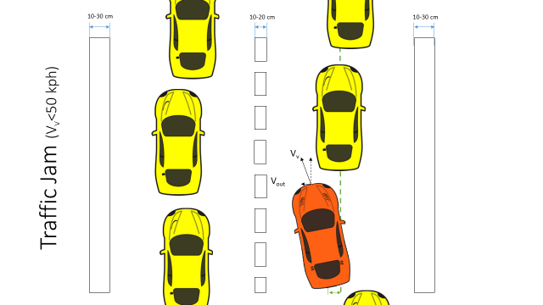
Active Lane Centering Functional Safety Phase 1 Presentation
A nshuman Singh
D avide Occello
R A ymond Wouters
S harad Bhadgaonkar, January 6th 2017

Slide 2
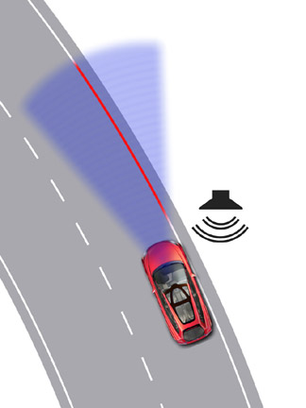
Agenda
Introduction
Project Timeline
Euro NCAP Requirements
Functional Safety Concept (ISO 26262)
Item Definition
Safety Relevant Use Cases
HARA & Safety Goals
Functional Architecture
Functional Safety Requirements
Improved Architecture
Conclusion & Future Work

Slide 3
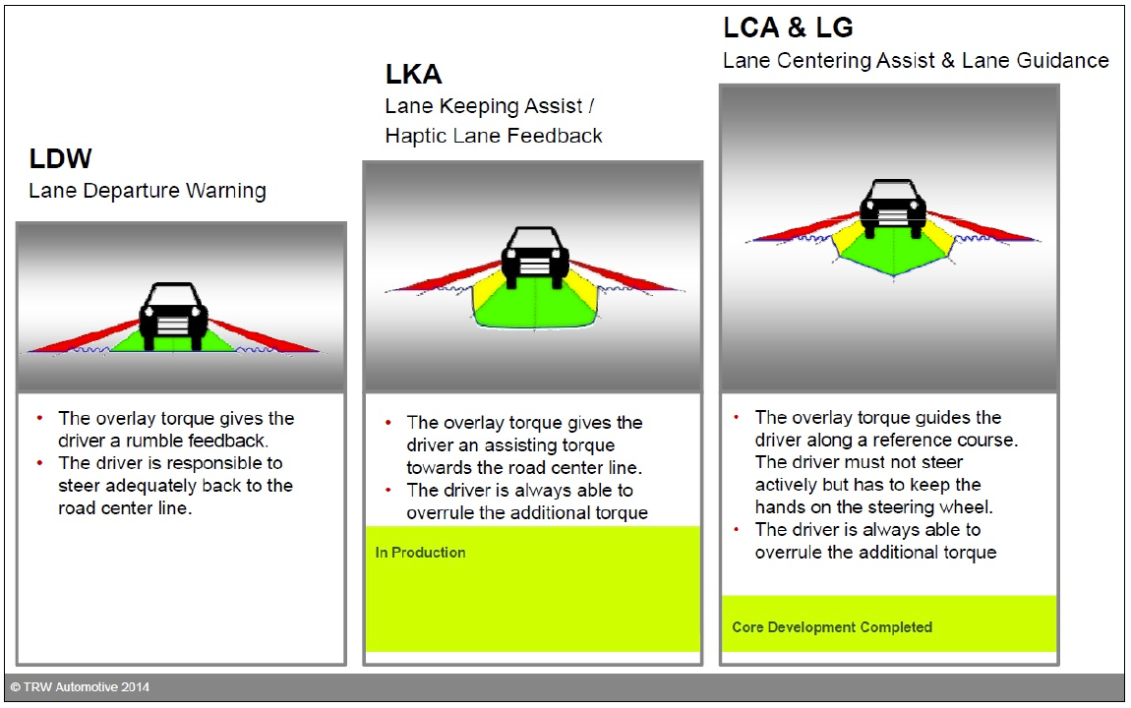
Introduction
Lateral Support Systems’ Evolution
Level of Assistance
Warning, no control
Control in dangerous conditions, Warn
Continuous Control, Warn

Slide 4
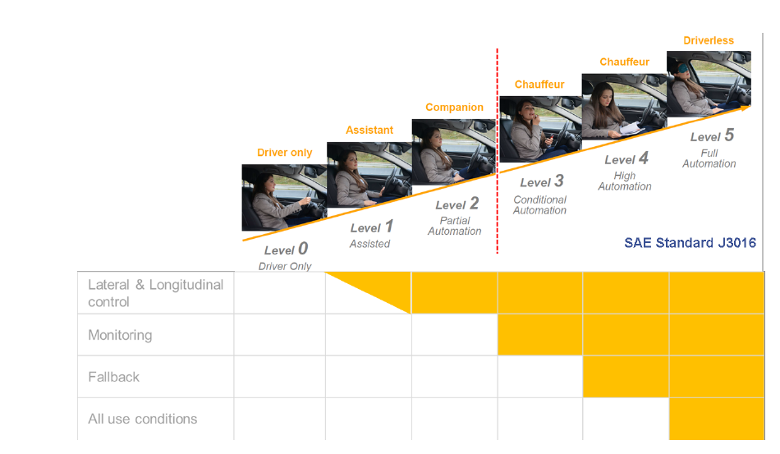
Introduction

Slide 5

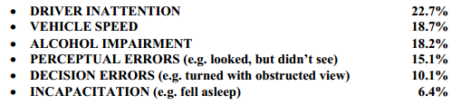
Introduction
Why Active Lane Centering System *
Safety
Comfort
Approach to avoid the scenario
Actively control the vehicle to the center of the lane (safest spot) to reduce the workload of the driver and the risk of collision.
Warn the driver if for any reason the car still moves in an unsafe zone.
* Hendricks, D. L., J. C. Fell, and M. Freedman. "The relative frequency of unsafe driving acts in serious traffic crashes." Report no: DOT-HS-809-206 (2001).

Slide 6
Project Timeline
Phase 1: Functional Safety
Phase 2:
Design
23 days
Phase 3: Implementation
25/11/16 – 13/01/17
26 days
12 days
43 days
55 days
2016
Nov
Dec
Jan
Feb
Mar
2017
Today
25.11.16
13.01.17
16.01.17
27.01.17
30.01.17
28.03.17
Project Kick Off
Project End

Slide 7
Project Timeline (Phase 1)
Phase 1:
Functional Safety
25/11/16 – 13/01/17
26 days
NCAP Requirements
2nd Dec
Documentation
12th Jan
CAFCR
9th Dec
HARA
14th Dec
FSR
20th Dec
2016
Nov
Today
Dec
Holidays
Jan
2017
25.11.16
13.01.17
End – Phase 1
Project Kick Off

Slide 8
EURO NCAP Requirements
This protocol specifies the Lateral Support Systems test procedure
Mainly information about the test conditions
Some Information on the other systems that are required in combination with the ALK/LDWS
Suggestions on the operation of the system

Slide 9
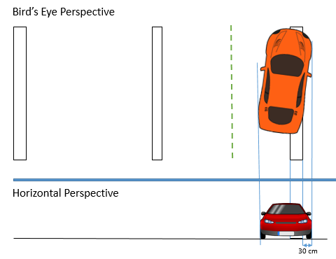
EURO NCAP Requirements
Examples from the NCAP document
(LKA/LDWS):
Test conditions: ALK should detect unintentional lane change at least, when the outside of the tire closest to the outside of the lane markings crosses 0.3 m or beyond.
System functionality: ALK shall use the lateral support system to restore control of the vehicle while countering the unintentional lane change.
Required Additional Systems: ALK system shall be available only if vehicle possess Electronic Stability Control system in compliance with regulatory requirements.

Slide 10
EURO NCAP Requirements
Example of additional Requirements for LCA
Original Requirement:
LKA: LKA shall use the lateral support system to restore control of the vehicle while countering the unintentional lane change.
( Source: EURO NCAP: Section1)
Modified Requirement:
LCA: LCA shall use the lateral support system to prevent loss of control of the vehicle while actively steering the vehicle to the center of the lanes.
(Source: Own requirement)

Slide 11
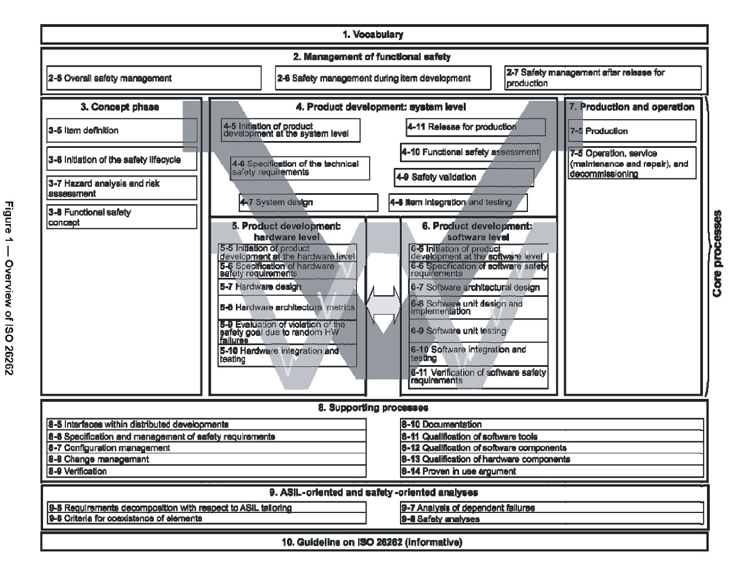
Functional Safety Concept (ISO 26262)

Slide 12
Item Definition
The main system function of a ‘Active Lane Centering System (ALCS)’ is:
Detect the unintentional drift outside the lane on which it is travelling
Actively steering the vehicle to the center of the current lane
The responsibility for the safe operation of the vehicle always remains with the driver.
Approach to Functional Safety
Warn the Driver and deactivate ALC when failures occur
Add redundancy for very important functionalities

Slide 13
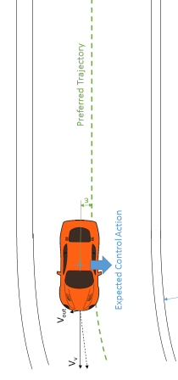
Scenarios
Visual Representation
Safety Relevant Use Cases
Target Environment: Highway*
Vehicle Speed
V_{v}= 50 -130 kph (normal operating conditions)
Lateral vehicle speed < 0.8 m/s
Lane markings according to the EU road network legislation
* Information derived from EURO NCAP requirement document

Slide 14



Straight Lane /
10-30 cm
10-20 cm
3.5-3.7 m
10-30 cm
V_{v}
R >1000 m
V_{out}
Expected Control Action
ε

Slide 15
Curve /
V_{out}
V_{v}
ε
Preferred Trajectory
Expected Control Action
R >250 m

Slide 16
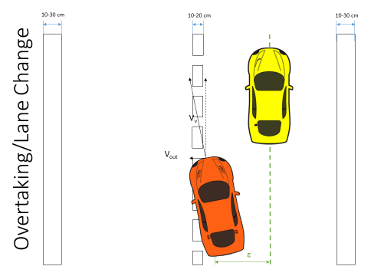
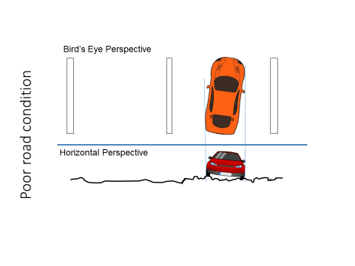
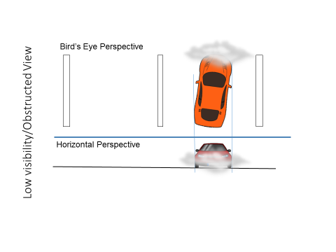
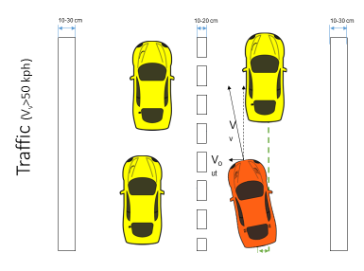

Slide 17


Traffic Jam (V_{v}<50 kph)
10-30 cm
10-20 cm
10-30 cm
V_{v}
V_{out}
ε

Slide 18
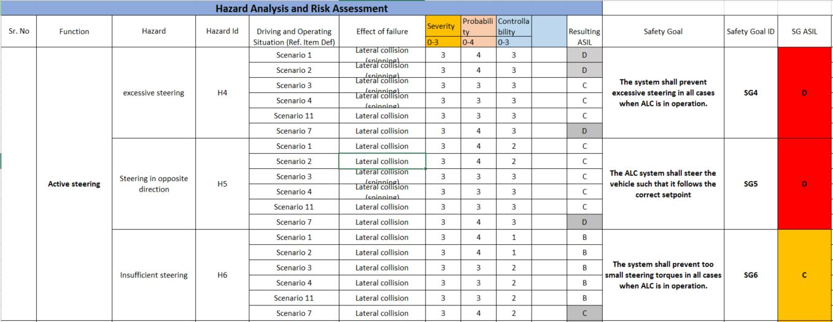
Hazard and Risk Analysis
+

Slide 19
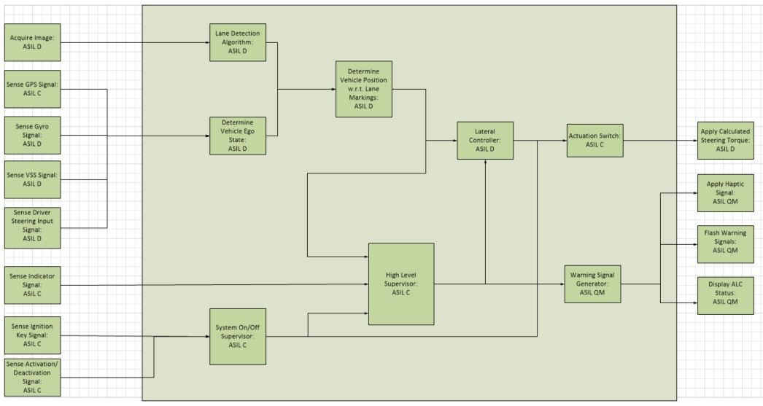
Functional Architecture
VISION
LOW LEVEL CONTROL
WARNINGS
INPUTS
SUPERVISORY
CONTROL

Slide 20
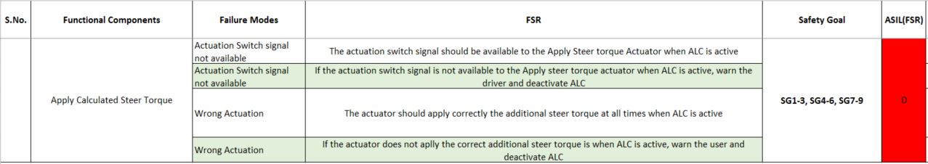
Functional Architecture

Slide 21
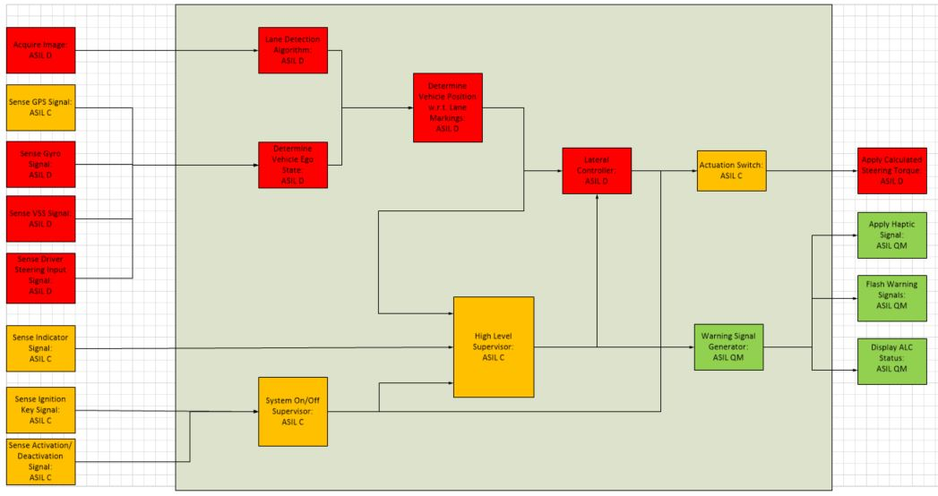
Functional Safety Concept

Slide 22
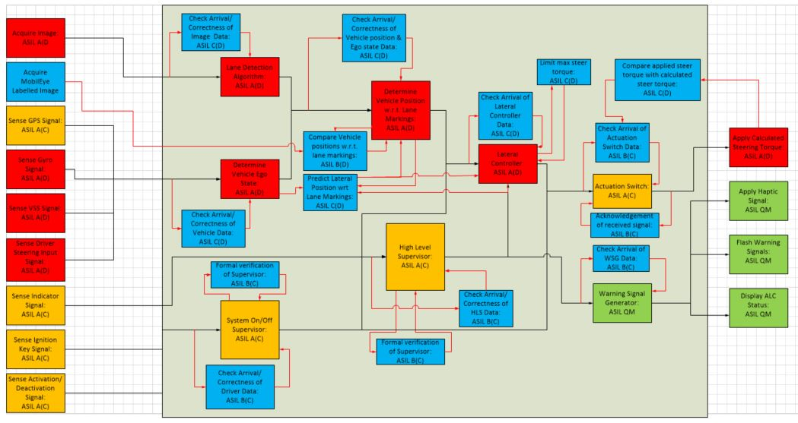
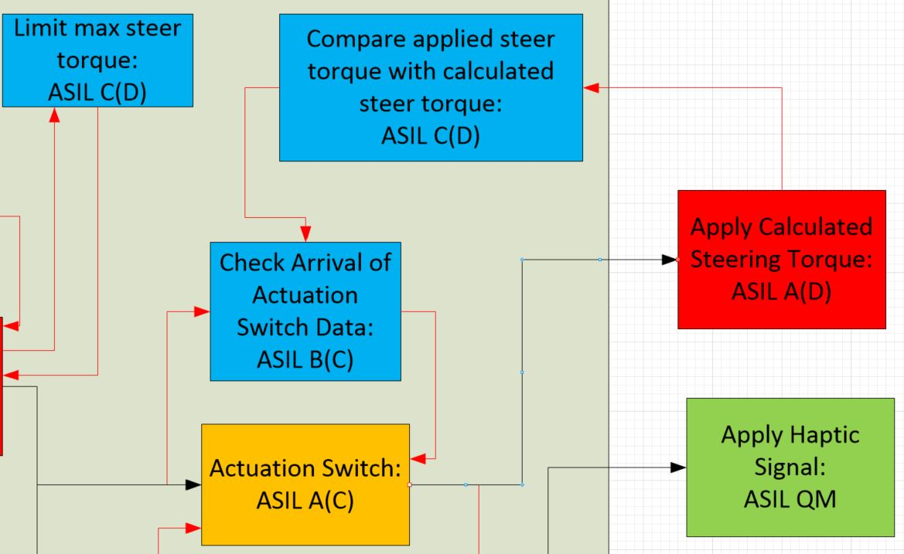
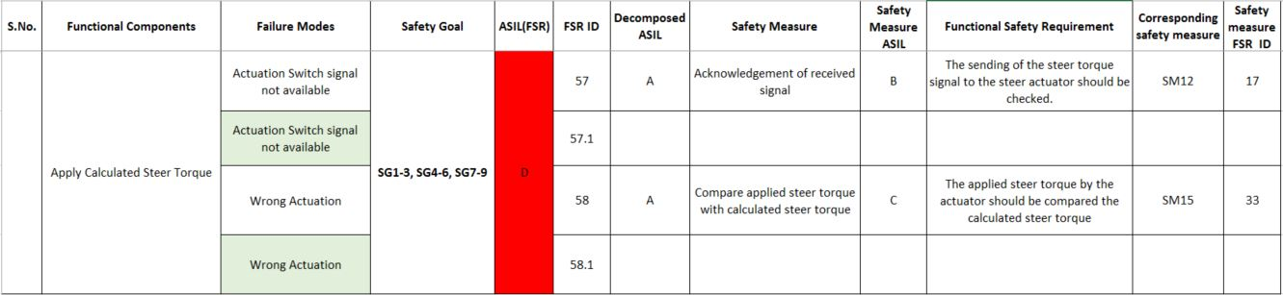
Safety Measures

Slide 23
Conclusions
Euro NCAP requirements for the ALC System
HARA
Safety Goals
Functional Safety Concept
Decomposed Functional Safety Concept

Slide 24
Future Work
Phase 2:
Current HW Architecture Analysis
Development of Improved System Architecture
High Level System Design Document

Slide 25
Questions
?

